Slide 1
protégé-owl api programmer's guide
http://protege.stanford.edu/protege/3.4/docs/api/owl/

Slide 2
Overview
The Protégé-OWL API is an open-source Java library for the Web Ontology Language (OWL) and RDF(S).
The API provides classes and methods to load and save OWL files, to query and manipulate OWL data models, and to perform reasoning based on Description Logic engines.

Slide 3
Overview
The API is designed to be used in two contexts:
  For the development of components that are executed inside of the Protégé-OWL editor's user interface
  For the development of stand-alone applications (e.g., Swing applications, Servlets, or Eclipse plug-ins)

Slide 4
Overview
Developers can initially wrap their components into a Protégé tab widget and later extract them to distribute them as part of a stand-alone application.

Slide 5
Overview
This guide will introduce you to some basic concepts of the Protégé-OWL API, no matter whether you intend to use it for stand-alone applications or Protégé plug-ins.
If you have trouble getting started, please post questions on the protege-owl mailing list.

Slide 6
Installation & Getting Started
The Protégé-OWL editor is bundled with the "full" installation of Protégé.
In addition to installing Protégé, you should download the source code from the Protégé Subversion repository.
http://smi-protege.stanford.edu/repos/protege/owl/trunk/ . Subversion.

Slide 7
Installation & Getting Started
Now let us configure our Java project and write a small "Hello World" application. If you are using a Java IDE such as Eclipse or IntelliJ, select the Protégé installation folder as your project home.
Next, add all the JAR files from the installation to your project classpath. Set your compiler output path to plugins/classes.

Slide 8
"Hello World" application
package com.demo.application;
import edu.stanford.smi.protegex.owl.model.OWLModel;
import edu.stanford.smi.protegex.owl.model.OWLNamedClass;
import edu.stanford.smi.protegex.owl.ProtegeOWL;
public class OWLAPIDemoApplication {
public static void main(String[] args) {
OWLModel owlModel = ProtegeOWL.createJenaOWLModel(); owlModel.getNamespaceManager().setDefaultNamespace("http://hello.com#"); OWLNamedClass worldClass = owlModel.createOWLNamedClass("World"); System.out.println("Class URI: " + worldClass.getURI());
}
}

Slide 9
"Hello World" application

Slide 10
Working with OWL Models
The Protégé-OWL API is centered around a collection of Java interfaces from the model package.
Using these interfaces you don't have to worry about the internal details of how Protégé stores ontologies.
These interfaces provide access to the OWL model and its elements like classes, properties, and individuals.

Slide 11
Working with OWL Models
The most important model interface is OWLModel.
Provides access to the top-level container of the resources in the ontology.
You can use OWLModel to create, query, and delete resources of various types.

Slide 12
Working with OWL Models
For example, the following snippet creates a new OWLNamedClass (which corresponds to owl:Class in OWL), and then gets its URI:
OWLModel owlModel = ProtegeOWL.createJenaOWLModel();
OWLNamedClass worldClass = owlModel.createOWLNamedClass("World");
System.out.println("Class URI: " + worldClass.getURI());
class ProtegeOWL provides a couple of convenient static methods to create OWLModels.

Slide 13
Understanding the Model Interfaces
RDFResource
RDFSClass
RDFProperty
RDFIndividual
The interfaces of the model package are arranged in an inheritance hierarchy.

Slide 14
OWLModel owlModel = ProtegeOWL.createJenaOWLModel();
OWLNamedClass personClass = owlModel.createOWLNamedClass("Person");
OWLDatatypeProperty ageProperty = owlModel.createOWLDatatypeProperty("age"); ageProperty.setRange(owlModel.getXSDint());
ageProperty.setDomain(personClass);
OWLObjectProperty childrenProperty = owlModel.createOWLObjectProperty("children"); childrenProperty.setRange(personClass);
childrenProperty.setDomain(personClass);
RDFIndividual darwin = personClass.createRDFIndividual("Darwin"); darwin.setPropertyValue(ageProperty, new Integer(0));
RDFIndividual holgi = personClass.createRDFIndividual("Holger"); holgi.setPropertyValue(childrenProperty, darwin); holgi.setPropertyValue(ageProperty, new Integer(33));

Slide 15
Creating Named Classes and Individuals
OWLNamedClass personClass = owlModel.createOWLNamedClass("Person");
// Create subclass (complicated version)
OWLNamedClass brotherClass = owlModel.createOWLNamedClass("Brother");
brotherClass.addSuperclass(personClass);
brotherClass.removeSuperclass(owlModel.getOWLThingClass())
A much more convenient way of creating a subclass of Person is as follows:
OWLNamedClass sisterClass = owlModel.createOWLNamedSubclass("Sister", personClass);
Person
Brother
Sister

Slide 16
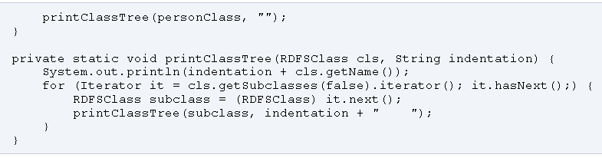
A simple recursive call can then be used to print arbitrary hierarchies with indentation:

Slide 17
Named classes can be used to generate individuals.
OWLIndividual individual = brotherClass.createOWLIndividual("Hans");

Slide 18
Using Object Properties to Build Relationships between Resources

Slide 19
Querying the OWLModel
This program produces the following output (using the "travel.owl" ontology):
Class Town (1)
- Coonabarabran
Class UrbanArea (0)
Class Destination (0)
Class RuralArea (2)
- CapeYork
- Woomera
Class QuietDestination (0)
Class FamilyDestination (0)
...

Slide 20
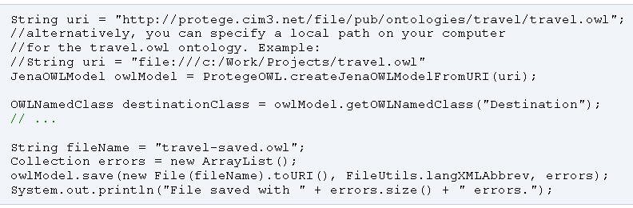
Loading and Saving Files

Slide 21
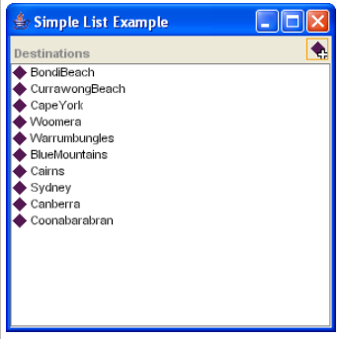
Protégé User Interface Programming

Slide 22
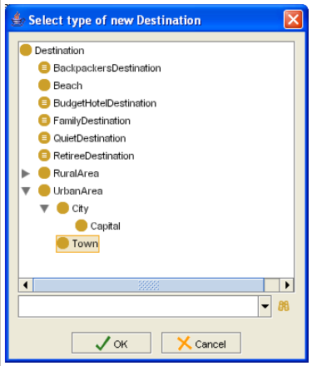

Slide 23
Tham khao them …

